Slide 1

Smart Environment Control System Using Fuzzy Logic
Fuzzy Logic Lab Project
Presentation
Submitted By
Ch Shafquatullah Nasir (20-CS-064)

Slide 2
Outline
Introduction
Problem Statement
Objective
Inference System
Linguistic Variables
Rules
Rules Viewer
Anfis Testing
03/5/24
Department of Computer Science , HITEC University, Taxila

Slide 3
Introduction
In today's world, the need for efficient environmental control systems is paramount, driven by the demand for sustainability and comfort.
Traditional control methods often struggle to adapt to the dynamic and uncertain nature of environmental variables.
Fuzzy logic presents a promising solution by offering a flexible and robust framework for decision-making in uncertain environments.
This project introduces a Smart Environment Control System (SECS) that leverages fuzzy logic to achieve optimal control over various environmental parameters.
Department of Computer Science , HITEC University, Taxila

Slide 4
Problem Statement
Traditional environmental control systems lack adaptability to dynamic environmental variables.
Rigid control algorithms often lead to suboptimal performance and energy inefficiencies.
Users may experience discomfort due to inadequate temperature, humidity, or air quality control.
Energy consumption remains unnecessarily high due to inefficient control strategies.
The problem statement involves designing a Smart Environment Control System (SECS) to address these limitations.
SECS aims to intelligently adapt to changing conditions and user preferences using fuzzy logic principles.
The goal is to achieve efficient, adaptive, and sustainable environmental control.
Department of Computer Science , HITEC University, Taxila
Notes:
The limitations are: It can be time consuming due to human interventation, hard to detect abnormalities at early stages, for complex tasks like fine-grained , computers are not as good as humans.

Slide 5
Objectives
Design a Smart Environment Control System (SECS) using fuzzy logic principles.
Develop an adaptive control mechanism capable of responding to dynamic environmental conditions.
Implement fuzzy logic algorithms to enable intelligent decision-making in environmental control.
Provide a scalable and flexible platform for integrating additional environmental sensors and control features
Contribute to the advancement of smart environmental control systems, promoting sustainability and efficiency.
Department of Computer Science , HITEC University, Taxila
Notes:
to develop an automated system that can analyze ultrasound images without human intervention. This will reduce the potential for human error and save time for healthcare professionals.
techniques to extract complex features from ultrasound images. This includes using convolutional neural networks (CNNs).
The system will classify fetal structures into different categories, such as identifying organs, limbs, and monitoring their development. This classification can be crucial for early detection of anomalies.
We aim to minimize the error rate and achieve a high level of accuracy in classification and diagnosis. We will validate the model's performance through rigorous testing and validation processes.

Slide 6
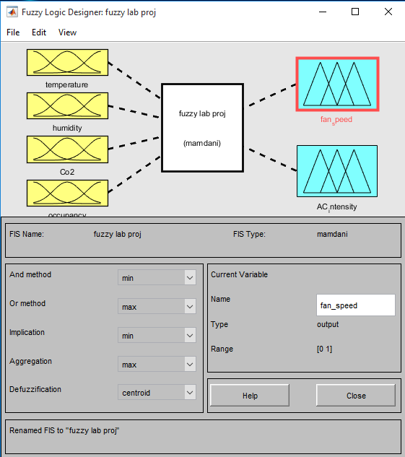
Inference System
Department of Computer Science , HITEC University, Taxila
Notes:
to develop an automated system that can analyze ultrasound images without human intervention. This will reduce the potential for human error and save time for healthcare professionals.
techniques to extract complex features from ultrasound images. This includes using convolutional neural networks (CNNs).
The system will classify fetal structures into different categories, such as identifying organs, limbs, and monitoring their development. This classification can be crucial for early detection of anomalies.
We aim to minimize the error rate and achieve a high level of accuracy in classification and diagnosis. We will validate the model's performance through rigorous testing and validation processes.

Slide 7
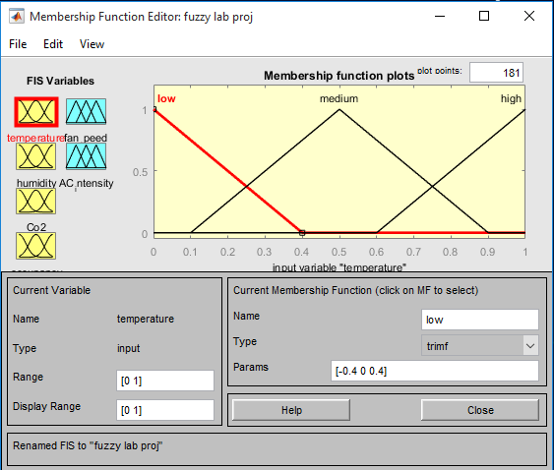
Linguistic Variables
Department of Computer Science , HITEC University, Taxila
Notes:
to develop an automated system that can analyze ultrasound images without human intervention. This will reduce the potential for human error and save time for healthcare professionals.
techniques to extract complex features from ultrasound images. This includes using convolutional neural networks (CNNs).
The system will classify fetal structures into different categories, such as identifying organs, limbs, and monitoring their development. This classification can be crucial for early detection of anomalies.
We aim to minimize the error rate and achieve a high level of accuracy in classification and diagnosis. We will validate the model's performance through rigorous testing and validation processes.

Slide 8
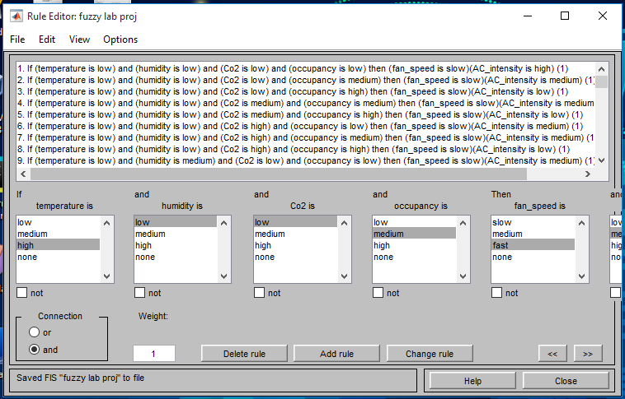
Rules
Department of Computer Science , HITEC University, Taxila
Notes:
to develop an automated system that can analyze ultrasound images without human intervention. This will reduce the potential for human error and save time for healthcare professionals.
techniques to extract complex features from ultrasound images. This includes using convolutional neural networks (CNNs).
The system will classify fetal structures into different categories, such as identifying organs, limbs, and monitoring their development. This classification can be crucial for early detection of anomalies.
We aim to minimize the error rate and achieve a high level of accuracy in classification and diagnosis. We will validate the model's performance through rigorous testing and validation processes.

Slide 9
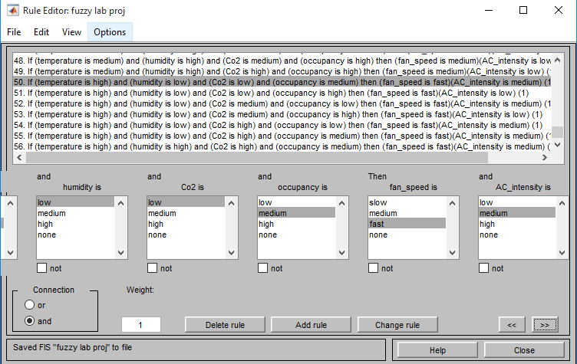
Rules
Department of Computer Science , HITEC University, Taxila
Notes:
to develop an automated system that can analyze ultrasound images without human intervention. This will reduce the potential for human error and save time for healthcare professionals.
techniques to extract complex features from ultrasound images. This includes using convolutional neural networks (CNNs).
The system will classify fetal structures into different categories, such as identifying organs, limbs, and monitoring their development. This classification can be crucial for early detection of anomalies.
We aim to minimize the error rate and achieve a high level of accuracy in classification and diagnosis. We will validate the model's performance through rigorous testing and validation processes.

Slide 10
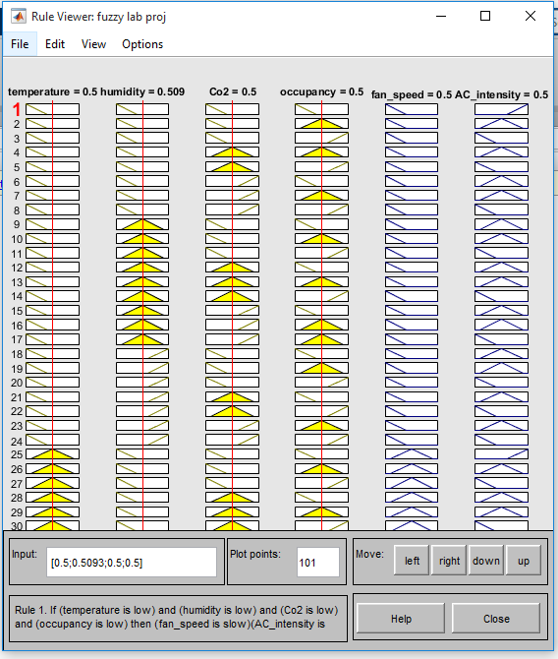
Rules Viewer
Department of Computer Science , HITEC University, Taxila
Notes:
to develop an automated system that can analyze ultrasound images without human intervention. This will reduce the potential for human error and save time for healthcare professionals.
techniques to extract complex features from ultrasound images. This includes using convolutional neural networks (CNNs).
The system will classify fetal structures into different categories, such as identifying organs, limbs, and monitoring their development. This classification can be crucial for early detection of anomalies.
We aim to minimize the error rate and achieve a high level of accuracy in classification and diagnosis. We will validate the model's performance through rigorous testing and validation processes.

Slide 11
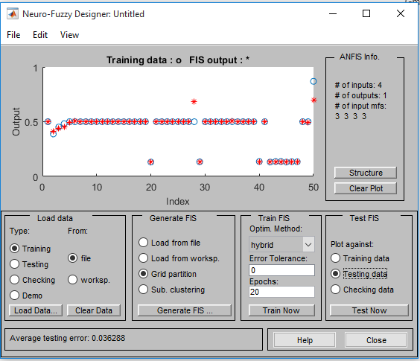
ANFIS Testing Results
Department of Computer Science , HITEC University, Taxila
Notes:
to develop an automated system that can analyze ultrasound images without human intervention. This will reduce the potential for human error and save time for healthcare professionals.
techniques to extract complex features from ultrasound images. This includes using convolutional neural networks (CNNs).
The system will classify fetal structures into different categories, such as identifying organs, limbs, and monitoring their development. This classification can be crucial for early detection of anomalies.
We aim to minimize the error rate and achieve a high level of accuracy in classification and diagnosis. We will validate the model's performance through rigorous testing and validation processes.

Slide 12
Thank You

